Slide 1
Synth Text

Slide 2
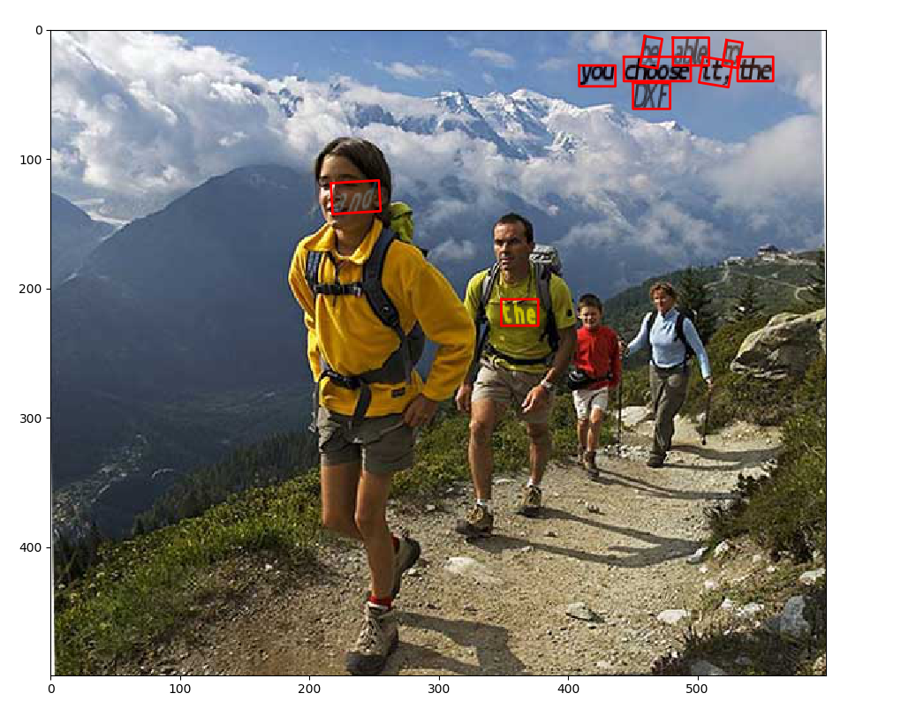
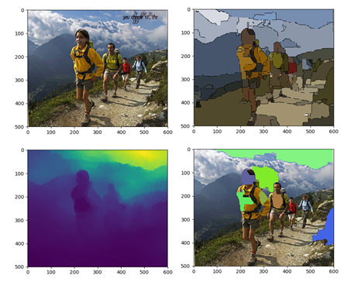
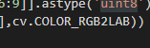
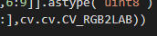
Synth Text

Slide 3
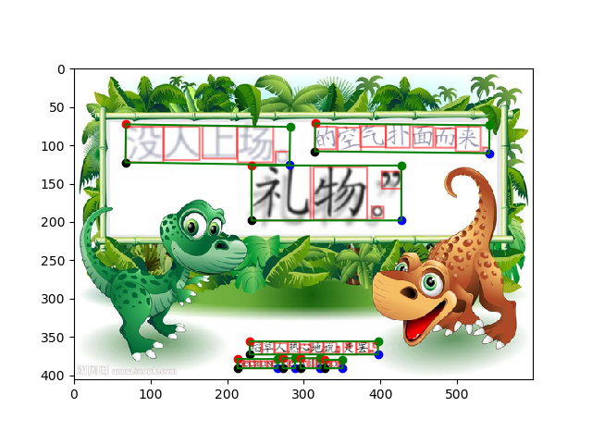
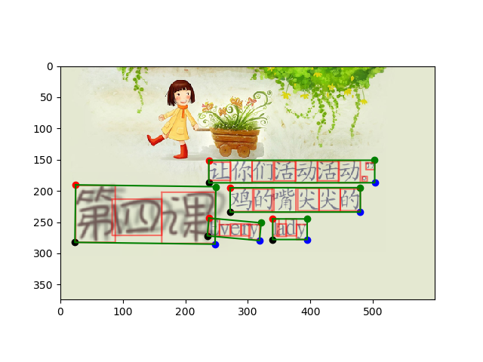
Synth Text Chinese

Slide 4
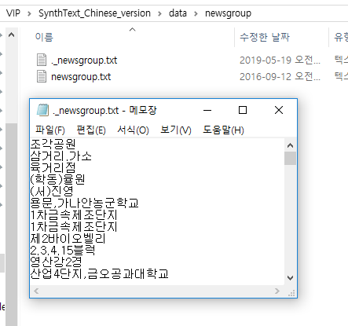
Synth Text Korean
Data/newsgroup에서 문자열을 가져옴

Slide 5
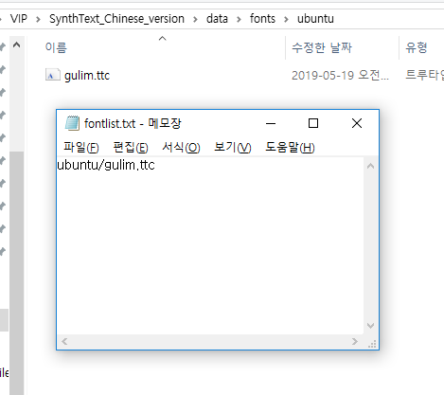
Synth Text Korean
Invert_font_size.py를 이용해 font_px2pt.cp를 인코딩

Slide 6
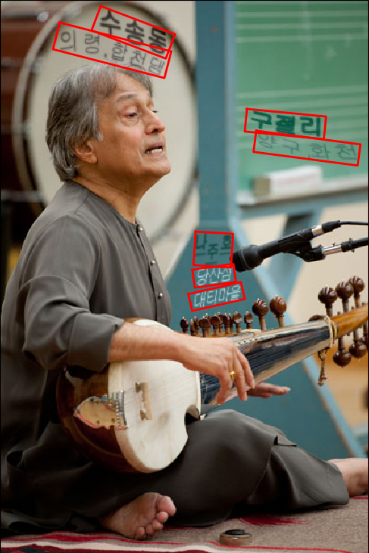
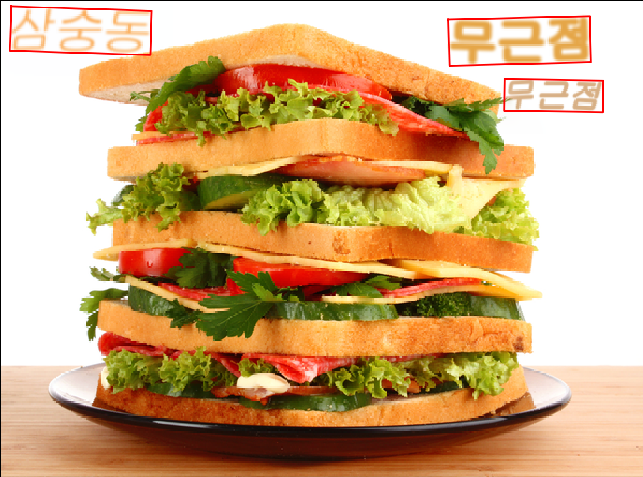
Synth Text Korean

Slide 7





Synth Text Korean

Slide 8
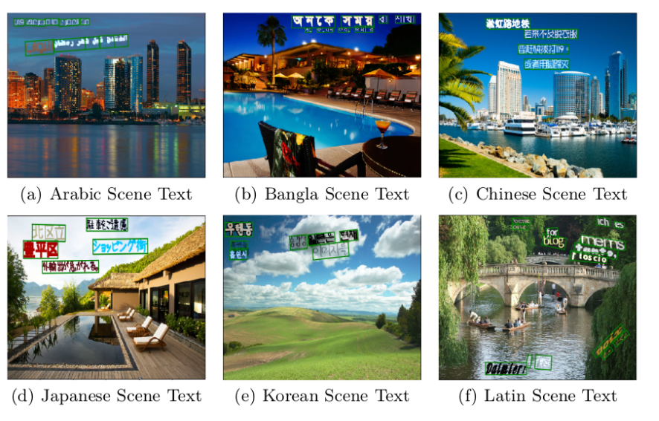
E2E-MLT

